Slide 1
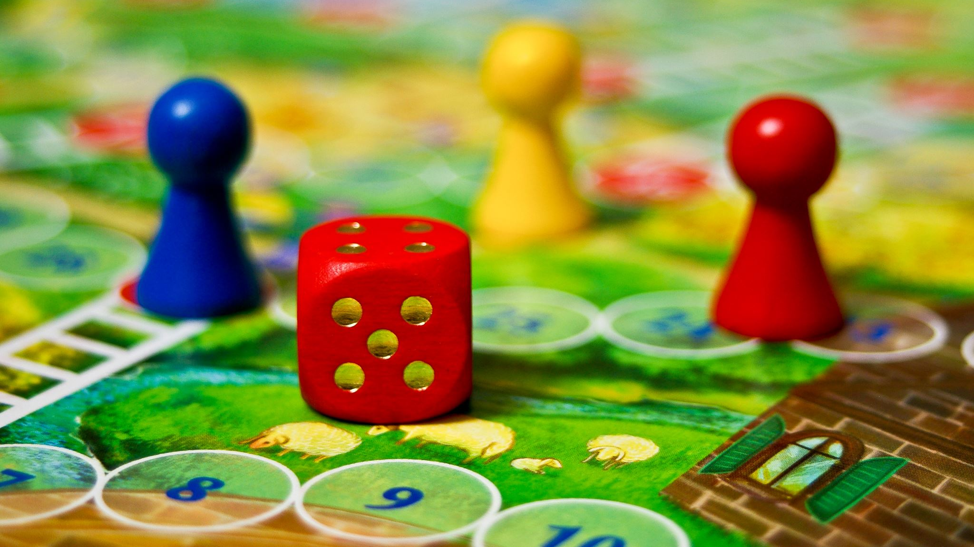
Solving a Zero-Sum Energy Combat Game
Zeyu Liang

Slide 2
Motivation and Game Description
Solving a game I played with friends when I was a kid with the knowledge I learned in graduate school
More complicated than RPS, but not over complicated
Two agent, each agent can make the 5 following actions: Store an energy(start 0 and max 2); make a small attack consuming 1 energy; make a big attack consuming 2 energy; defend from small attack; defend from big attack. Two agents act simultaneously.
Key note: big attack defense can not block small attack; If both agent attack at the same time, either they cancelled out or the one with bigger energy attack wins.

Slide 3
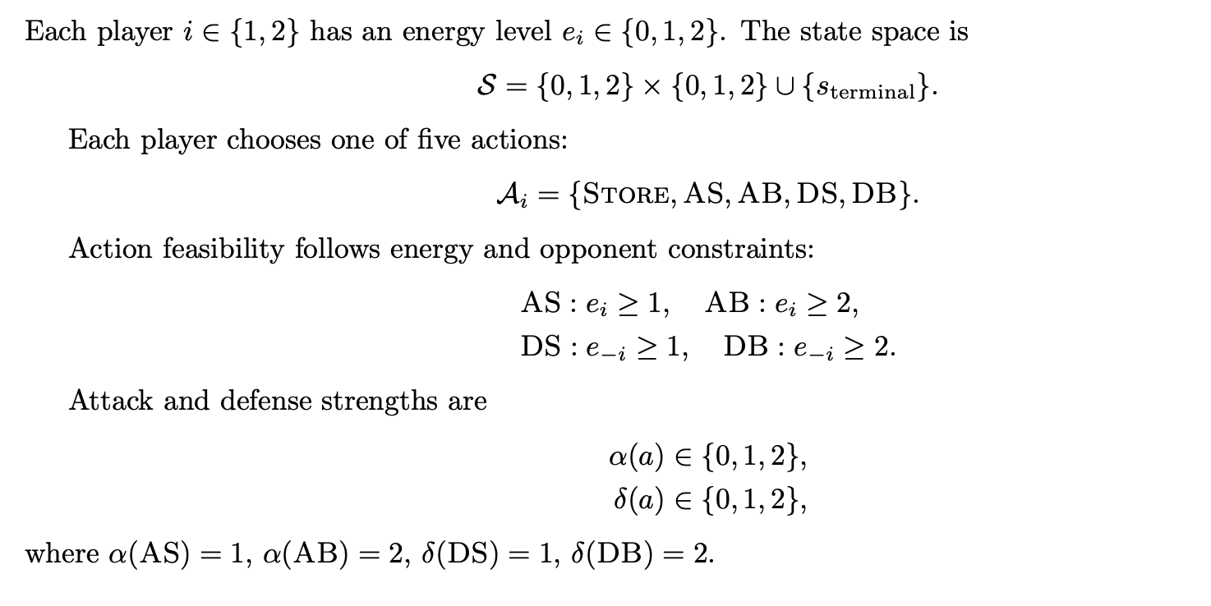
Math model of this Game
G= (S,A1,A2,P,r,γ)

Slide 4
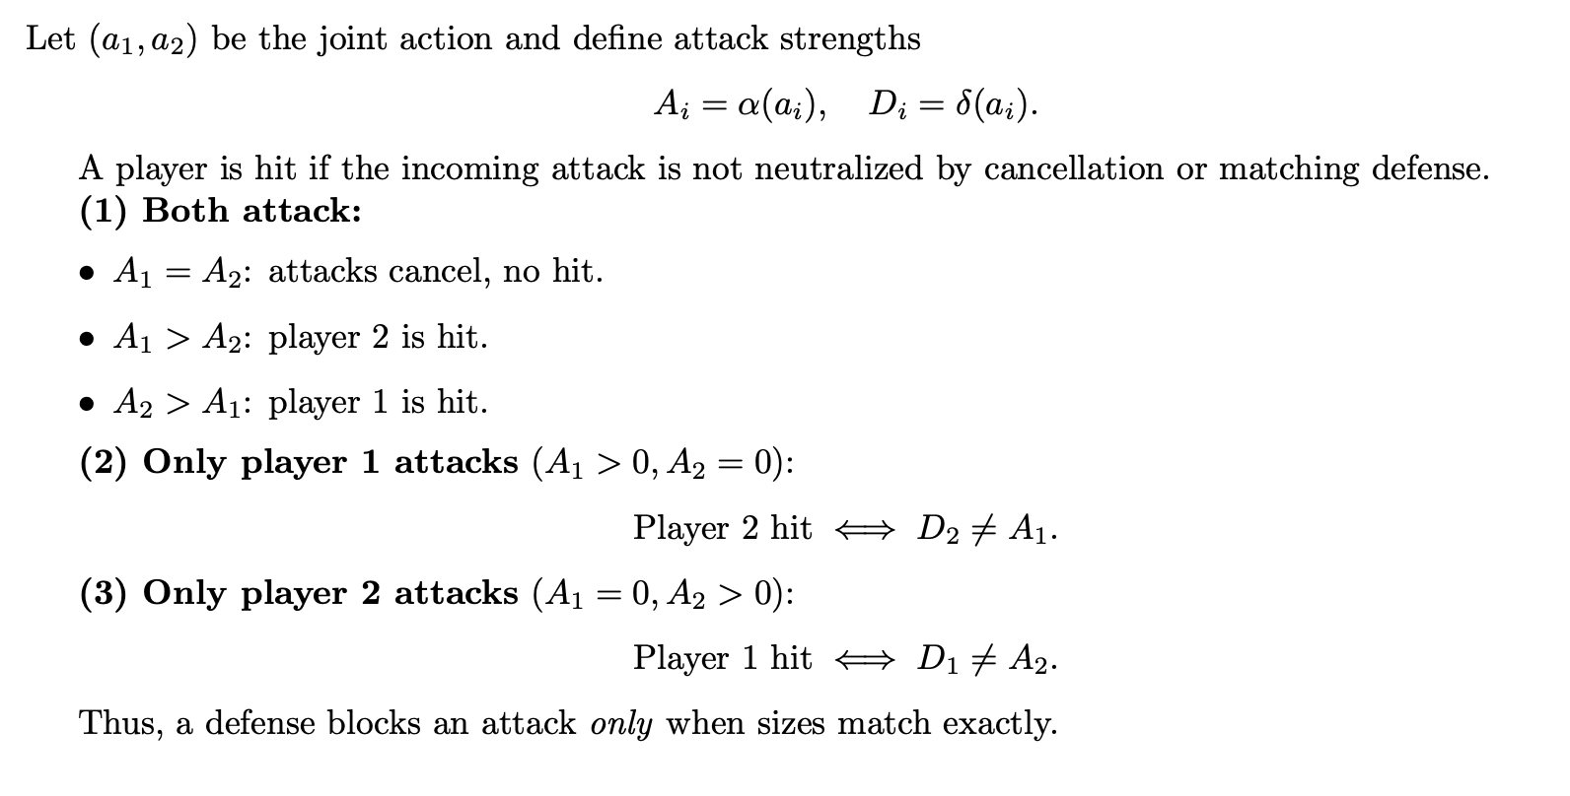
Math model of this Game

Slide 5
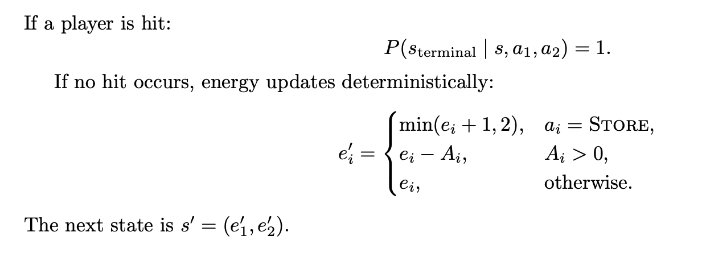
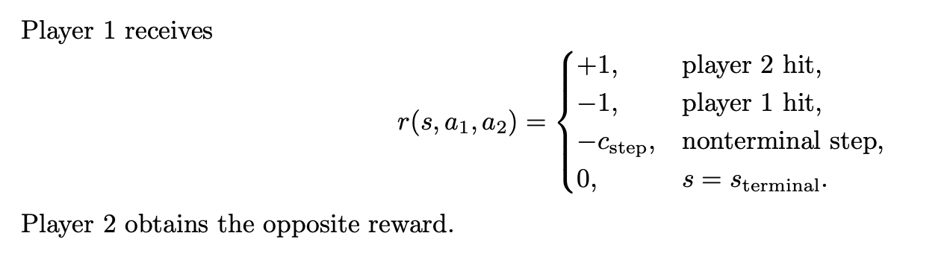
Math model of this Game

Slide 6
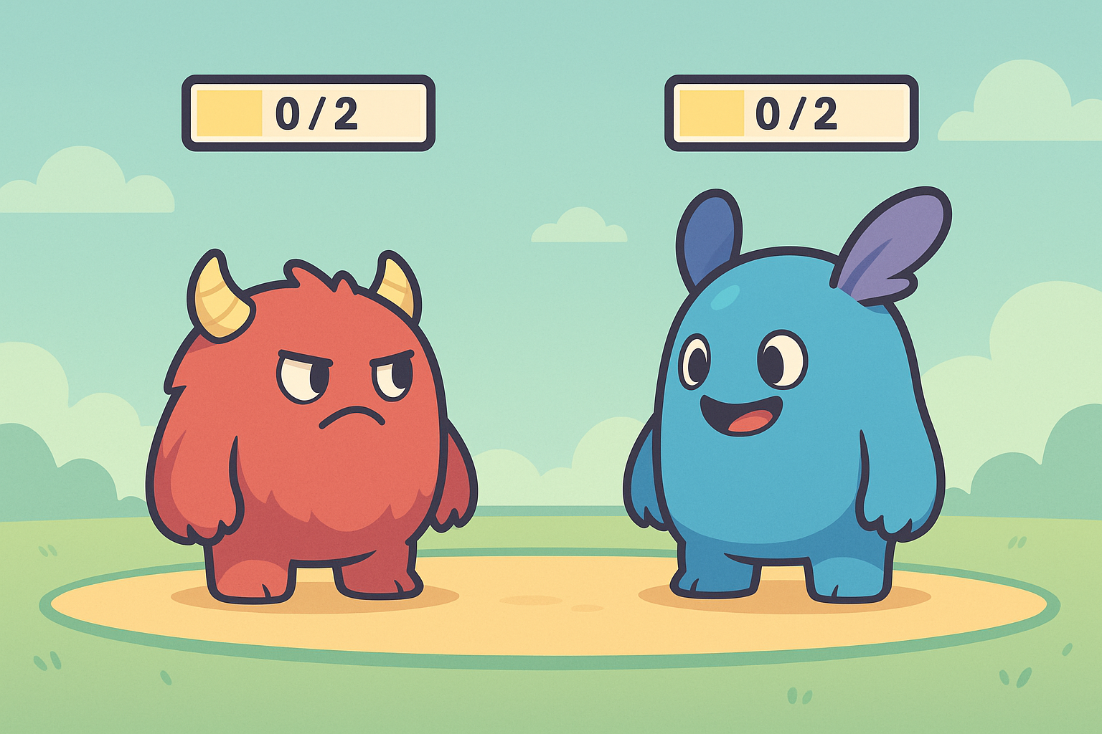

Slide 7
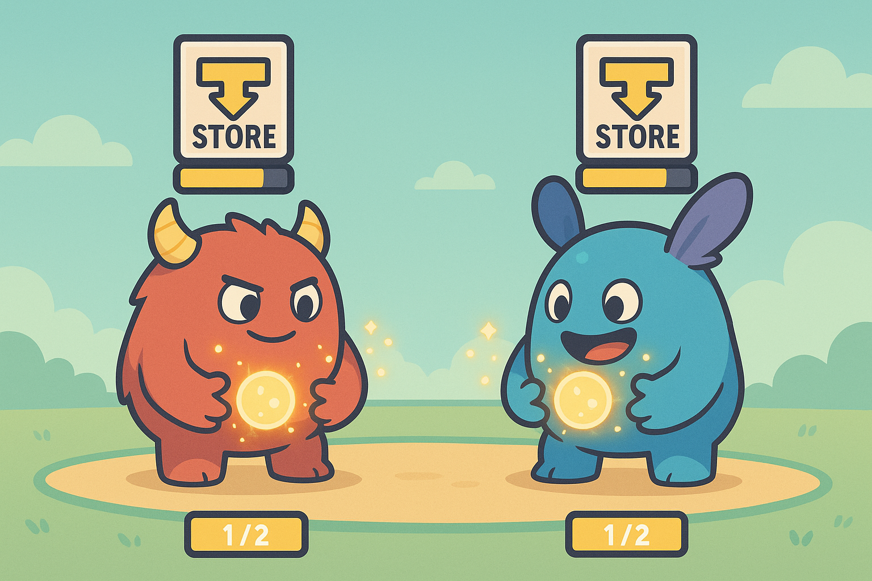

Slide 8
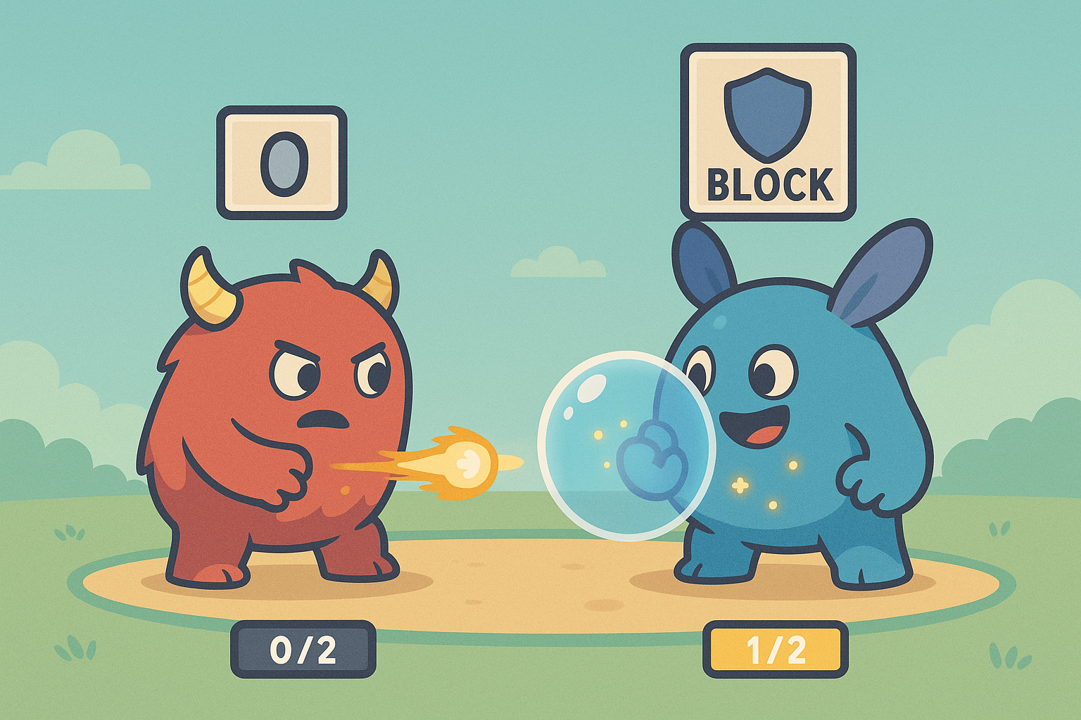

Slide 9
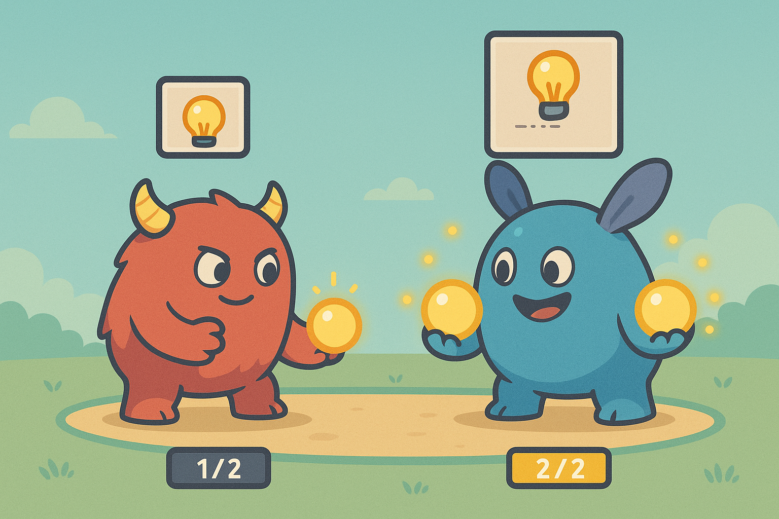

Slide 10
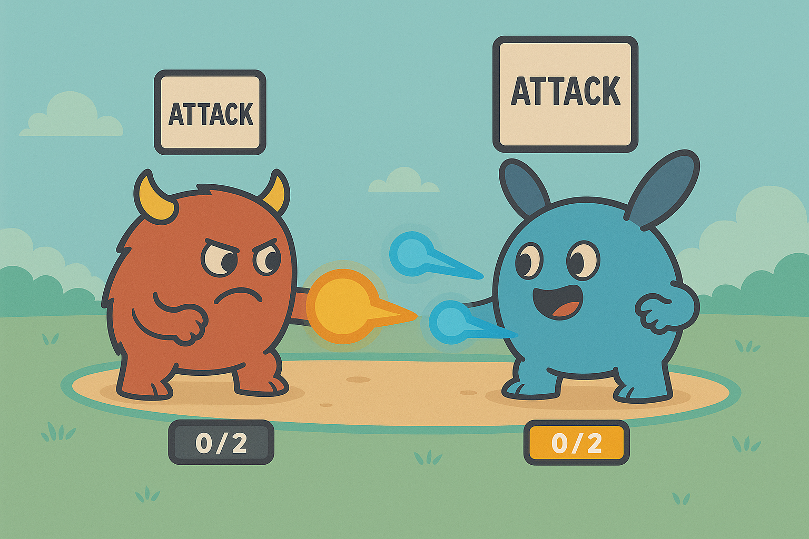

Slide 11
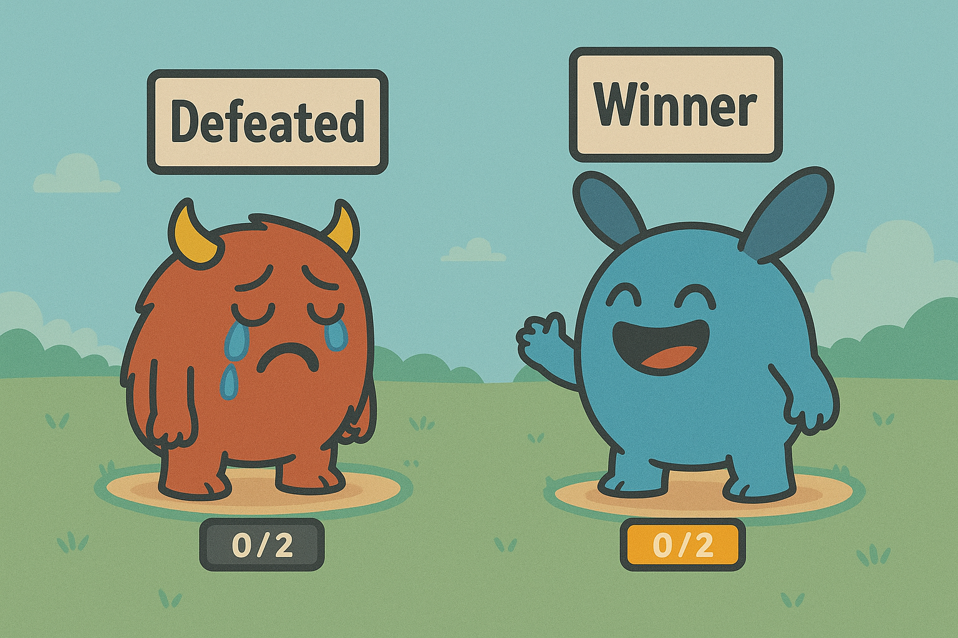

Slide 12
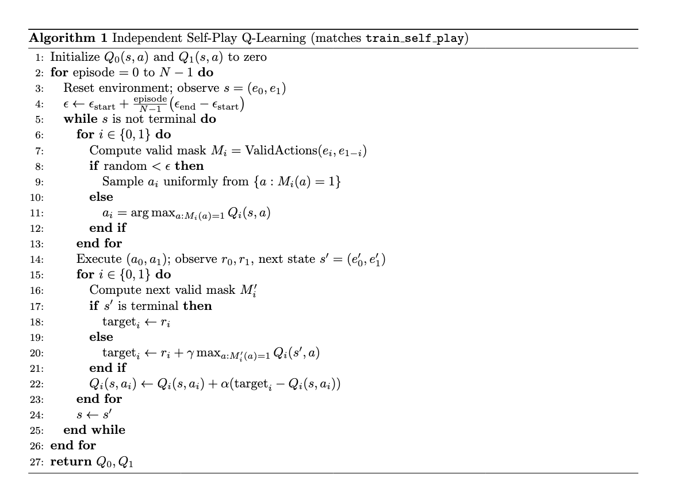
Self-Play Q-Learning

Slide 13
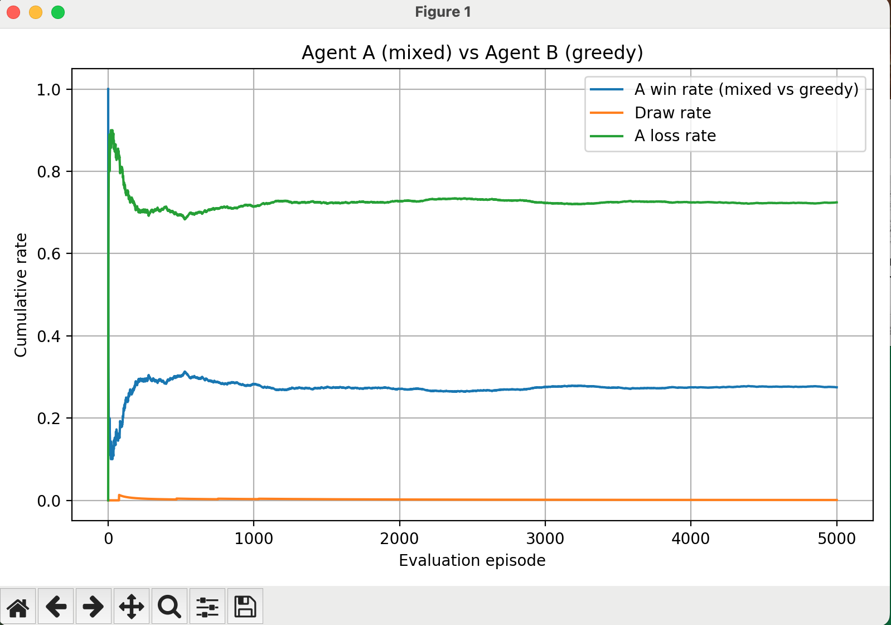
Greedy vs Mixed Policy
Greedy wins 72.4% of the time

Slide 14
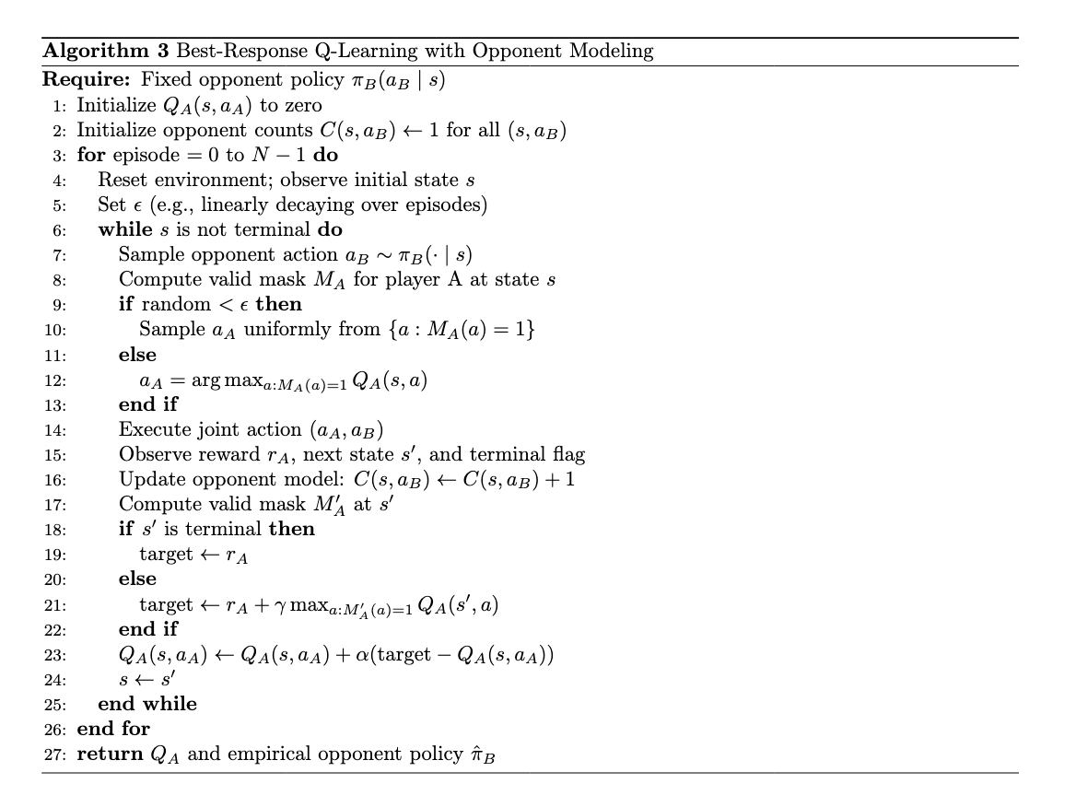
Opponent Modeling

Slide 15
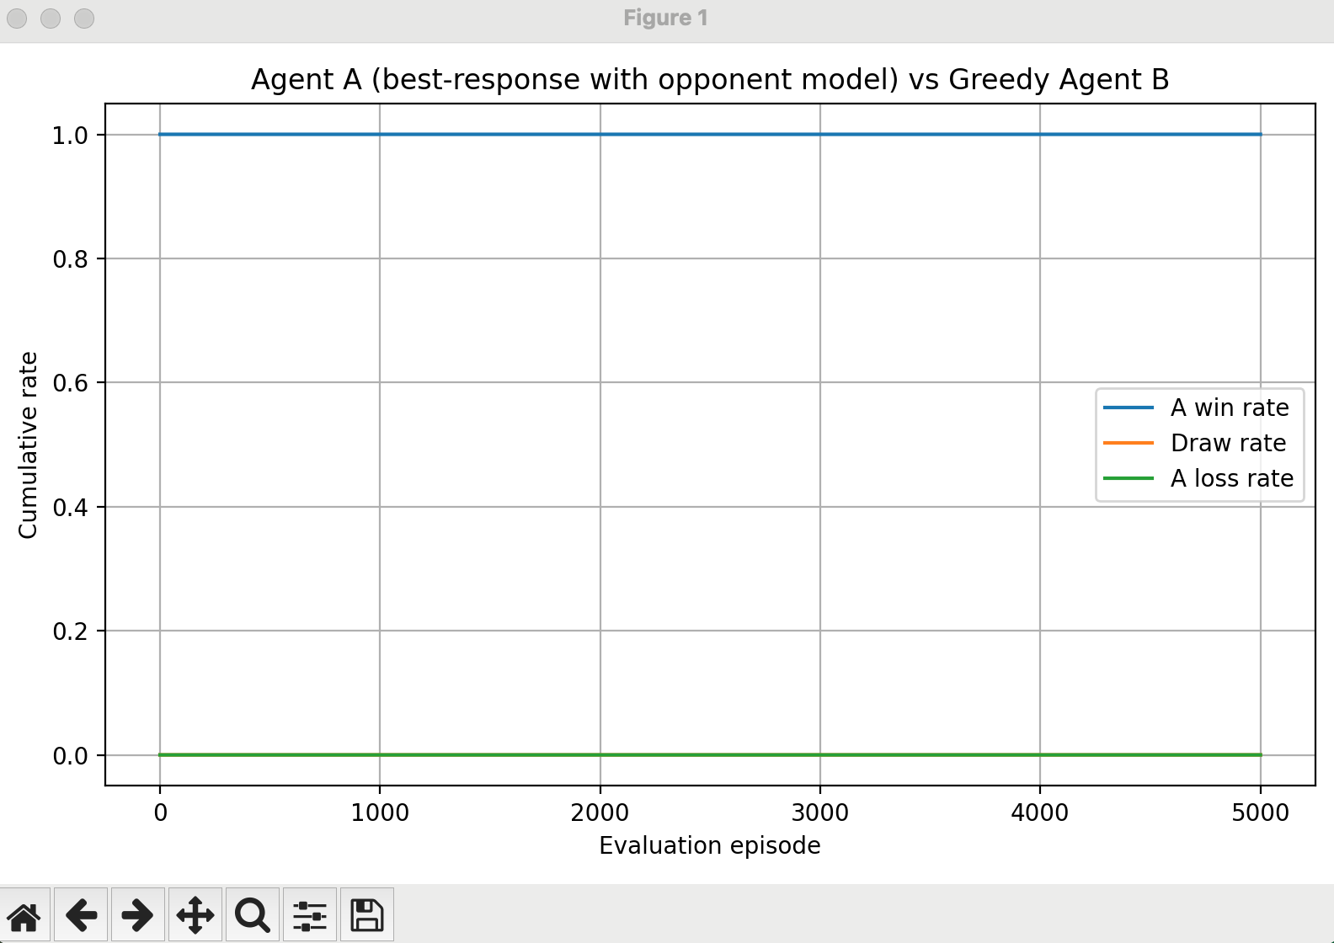
Opponent Modeling vs Greedy

Slide 16
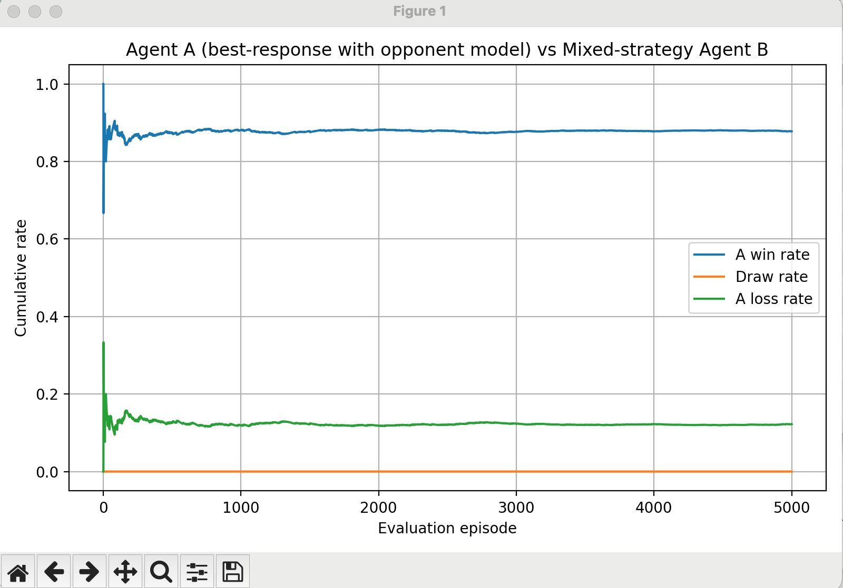
Opponent Modeling vs Mixed Policy
Opponent Modeling wins 84.2% of the time

Slide 17
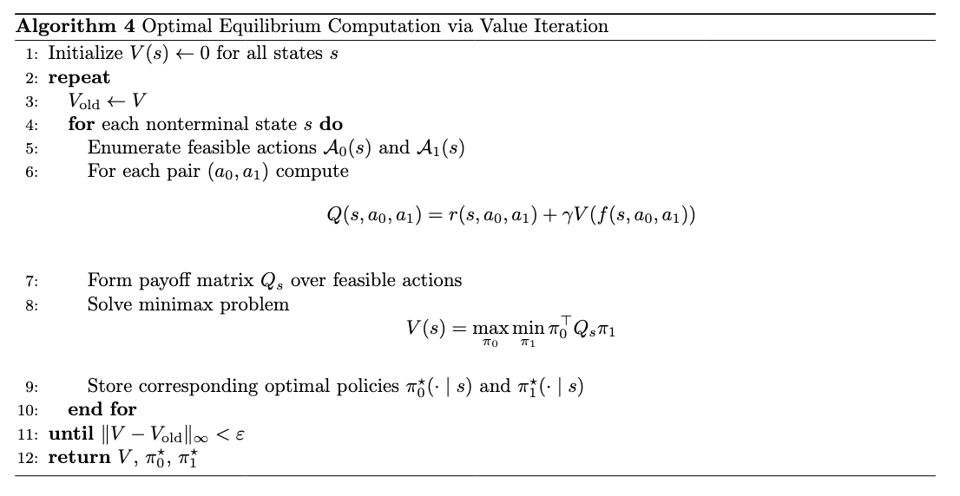
Min-Max approach(Brute force enumeration)

Slide 18
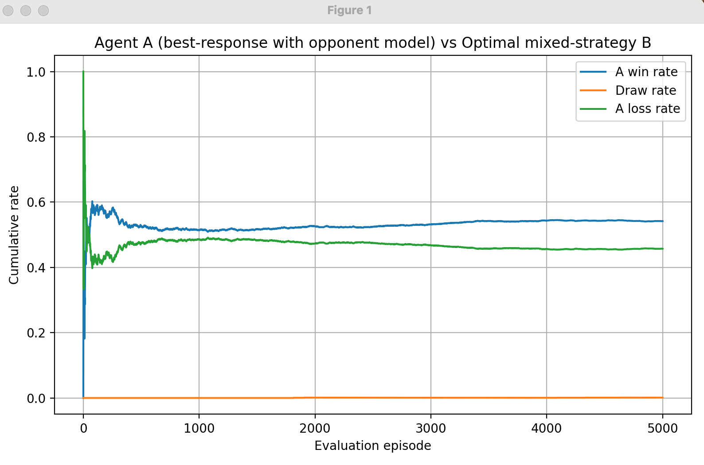
Opponent Modeling vs Optimal Policy
Opponent Modeling wins 54.6% of the time

Slide 19
Reflection on why Q-learning might not work in energy game but still works for RPS
RPS is extremely simple, and its actions are symmetric
Q-Learning is not stable in non-stationary environment like this one, Q-learning favors pure strategies rather than stochastic strategies.
My Takeaways: Improved my math modeling ability;Get to implement Q-learning and deepen my understanding on when to apply it; Get to learn and implement Opponent-Modeling
Thanks for watching!

